Slide 1



Patient reported outcome measures in SMA
Sonia Messina
Department of Clinical and Experimental Medicine, University of Messina, Italy
NEMO SUD Clinical Center, Messina, Italy

Slide 2
Patients’ and carers’ prospective in SMA
With the exciting advances in therapeutic strategies, there has been an increasing pressure from regulatory authorities and from the SMA community to capture patients and carers’ prospective on the impact of the new treatments on their ‘quality of life’.
While some of the tools used in clinical trials are questionnaires specifically addressing health related quality of life (HRQoL) aspects, others are more specifically designed to assess “activities of daily living” (ADLs) or “caregiver burden”.
The different tools are assessing aspects that are overall related to each other, but their constructs and their aims are different (Broe et al., 1998 ; Millán-Calenti et al., 2010 ).
In the scientific community there is still confusion regarding these terms and the focus of the different available tools.

Slide 3
- What do we know about different tools used in SMA?
- What are the differences/similarities in what they capture?
Critical review the existing patient/parent/carer reported tools used in SMA

Slide 4
Definition - HRQoL
HRQoL is the degree to which a medical condition impacts on a multidimensional construct, consisting at the minimum of physical, psychological (including emotional and cognitive) and social health dimensions delineated by the World Health Organization.
HRQoL measures can be categorized as generic or disease−specific.
Generic HRQoL measurement instruments enable comparisons across pediatric populations and facilitate benchmarking with healthy population norms.
Disease−specific measures enhance measurement sensitivity for health domains germane to a particular chronic health condition.
(FDA, 2006, WHO, 1948, Khanna et al. 2007).

Slide 5
Definition - ADLs
- The term ADLs refers to activities an individual should perform to manage basic physical needs in order to live independently;
These generally include a number of area related to physical functioning, feeding, personal hygiene, dressing, toileting and transferring/moving around indoors and outdoors;
More complex activities, such as meal preparation, using public transportation are generally more often explored in adults with possible cognitive impairment and are referred as Instrumental ADL.
(Boyle, Cohen, Paul, Moser, & Gordon, 2002 ; Cahn-Weiner et al., 2007 )

Slide 6
Definition - care giver burden
The term care giver burden is generally used to include not only the physical burden related to the care, but also the psychological, social and financial burden that is experienced when providing care.
When caregivers are within the family, their role is more complex and associated with multidimensional responsibilities and a higher psychological and emotional involvement.
More recently there has been an effort to separate ‘objective’ burden’, that mainly refers to the more physical or instrumental aspects of care, from ‘subjective burden’ referring to the emotional or psychological aspects.

Slide 7
AIMS
To critically review the existing patient/parent/carer reported tools used in SMA. In order to do so we expanded the search beyond the term ‘HRQoL’ in order to identify other tools related to ADLs and care burden, that also have an impact on HRQoL.
to explore which aspects were assessed by the individual measures and to establish a roadmap of their appropriateness in relation to age and functional status.
to establish if and which of the existing tools include items that can be related to possible functional changes in clinical trials or, more generally following an intervention.

Slide 8
Results
- From the review of the literature, a total of 1170 articles were preliminarily selected based on their title.
- After reviewing the full abstracts, 173 were selected for review of the full paper.
- After reviewing the full paper, 48 papers were selected, reporting a total of 31 measures previously used in SMA or cohorts on neuromuscular disorders including SMA.
- We also identified another 4 measures (WPAI, SMAIS, ITQOL47, SMA HI) that had not been published in full papers in relation to SMA or other pediatric neuromuscular disorders, but are or have been used in recent or ongoing SMA natural history studies or clinical trials.
- This resulted in a total of 35 measures identified.

Slide 9
Results- Identification of assessed aspects
 | QoL | ADL | CARE BURDEN | SMA TYPE | Details/comments | References of studies including SMA patients | used in SMA trials/NH studies
PEDSQL core | ✔ |  |  | 1,2,3 | Child self reported (5-18 years) and care giver reported (or children ages 2-18 years). Generic tools to assess HRQL in children | Iannaccone et al. 2002, 2003, and 2009, Mah et al. 2008, Dunaway et al. 2010 | NCT02908685 NCT02628743 NCT02594124
PEDSQL NMM | ✔ |  |  | 1,2,3 | Child Self reported (5-18 years) and care giver reported (for children ages 2–18 years). Disease-specific modules for NMD. (validated in SMA and DMD) | annaccone et al. 2002, 2003, and 2009, Dunaway et al. 2010, Kocova et al. 2014, Dunaway et al. 2010, Klug et al. 2016 | NCT02908685 NCT02628743 NCT02594124
QoL-NMD | ✔ |  |  | 2,3 | Patient self reported (>18 years). Specifically developed for NM disorders | Dany et al. 2015, 2017 a and 2017 b | no
WHOQOL-BREF | ✔ |  |  | 2,3 | Patient self reported (>18 years). Generic questionnaire to assess HRQOL | Dany et al. 2015, 2017 a and 2017 b | no
AUQUEI | ✔ |  |  | 1,2,3 | Child self questionnaire (from 6 to 10 years of age). Generic tools to assess QoL in children. | De Oliveira et al. 2011 | no
LSI-A | ✔ |  |  | 1,2,3 | self (8-18 years) and caregiver reported (5-18 years). Wide range of functional status. Developed for DMD. | Simon et al. 2017 | no
SOLE | ✔ |  |  | 1,2,3 | Self reported questionnaire (5-18 years). Developed for children with NMD | Orcesi et al. 2014 | no
Rosenberg Self Esteem Scale (RSES) | ✔ |  |  | 2,3 | Self reported questionnaire more oriented for adults (>18 years of age) Generic tool to assess individual’s self esteem | Fisher et al. 2019 | no
Duke Health Profile | ✔ |  |  | 2,3 | Self-administered questionnaire more oriented for adults person. Generic instrument. | Rapin et al. 2016 | no
Satisfaction with Life Scale (SWLS) | ✔ |  |  | 2,3 | Self reported questionnaire more oriented for adults. Generic tool to assess psychological well being | Fisher et al. 2019 | no
SMA HI | ✔ |  |  | 2,3 | Self reported>12 years. DEVELOPED FOR SMA | Proceedings CURE SMA 2018 | natural history
11/35 mainly focused
on HRQoL

Slide 10
Results- Identification of assessed aspects
 | QoL | ADL | CARE BURDEN | SMA TYPE | Details/comments | References of studies including SMA patients | Used in SMA trials
SF-36 | ✔ | ✔ |  | 2,3 | Self-reported questionnaire more oriented for adults ( > 14 years). Generic instrument. | Boyer et al. 2005, Abresch et al. 2002, Kruitwagen et al. 2016 and 2018, Suk et al. 2015, Read et al. 2010 | NCT02628743
EQ 5D 5L EQ 5D y EQ 3 | ✔ | ✔ |  | 2,3 | Self reported questionnaire and caregivers reported module. Generic instruments to assess health status in a wide range of ages. | Lopez-Bastida et al. 2017 | NCT02908685 NCT02628743
Nottingham Health Profile | ✔ | ✔ |  | 2,3 | Self-administered questionnaire more oriented for adults person. Generic instrument. | Boyer et al. 2005 and 2006, Yilmaz et al. 2010 | no
SIP 68 | ✔ | ✔ |  | 2,3 | Self reported questionnaire General health measure. | De Groot et al. 2005 | no
Utrecht Scale (USER-Participation) | ✔ | ✔ |  | 3 | Self reported questionnaire for adults (>18 years). Generic tool to assess participation. | Fisher et al. 2019, Kruit et al. 2018 | no
ITQOL-SF47 | ✔ | ✔ |  | 1,2,3 | parent-completed (2–72 months) Generic profile measure |  | NCT02913482
FLASH SURVEY SMA | ✔ | ✔ |  | 2,3 | Self-reported and care giver reported developed to appraise the expectations on current therapeutic developments in type 2 and 3 SMA patients. DEVELOPED FOR SMA | Rouault et al. 2017 | no
International survey (1) | ✔ | ✔ |  | 2,3 | Self-reported and care giver reported. Specifically developed to assess the meaningfulness of functional items and the expectations on current therapeutic developments in type 2 and 3 SMA patients. DEVELOPED FOR SMA | Pera et al. 2017 | no
International survey (2) | ✔ | ✔ |  | 2,3 | Self-reported and care giver reported. DEVELOPED FOR SMA | Qian et al. 2015 | no
PRISM SMA | ✔ | ✔ |  | 2,3 | Self-reported (adults) assessing how different symptoms affect adult life in SMA, DEVELOPED FOR SMA | Mongiovi’ et al. 2018 | no
10/35 focused
on HRQoL and ADL
4 of these 10 were surveys.

Slide 11
Results- Identification of assessed aspects
 |  | QoL | ADL | CARE BURDEN | SMA TYPE | Details/comments | References of studies including SMA patients | Used in SMA trials
EK2 |  |  | ✔ |  | 2,3 | Self reporting questionnaire for non ambulant teen agers and adults. Specific tool designed to measure functional ability in wheelchair person with DMD and SMA. | Steffensen et al. 2201 and 2002, Fagoaga et al. 2015a and b, Cano et al. 2014, Welauf et al. 2014 | no
ACTIVLIM |  |  | ✔ |  | 1,2,3 | Self reported and parents version (6-80 years) form includes questions for both NA and A and some for A only. Specific tool designed to assess activity limitations in patients with NMD | Vandervelde et al. 2007 and 2009, Batcho et al. 2016 | no
PEDI CAT |  |  | ✔ |  | 1,2,3 | Caregiver- reported form for a wide age range (1 to 21 years) and functional status (non sitters to ambulant). Generic tool to assess the performance level for children and young adults with disabilities. | Pasternak et al. 2016 | no
Barthel index |  |  | ✔ |  | 2,3 | Self reported or care giver reported >12 y. Generic tool to evaluate physical disability. | Lopez-Bastida et al. 2017, Dany et al. 2017 | no
Wee-FIM |  |  | ✔ |  | 1,2,3 | Self or proxy- reported questionnaires (children up to 3 years of age to adult ages) Generic instrument to assess functional independence level in children and adults | Pousada et al. 2018, Yilmaz et al. 2010, Vuillerot et al. 2010, Chung et al. 2004 | no
- 5/35 tools mainly focused on ADLs

Slide 12
Results- Identification of assessed aspects
 | QoL | ADL | CARE BURDEN | SMA TYPE | Details/comments | References of studies including SMA patients | used in SMA trials
ACEND |  |  | ✔ | 1,2,3 | Care giver reported , form includes questions for a wide range (4-18 years) of age and functional status (non sitters to ambulant). Instrument specifically designed to assess the caregiver burden of children with NMD. | Matsumoto et al. 2011 | NCT02594124
Zarit Burden Interview |  |  | ✔ | 1,2,3 | Care giver reported (> 5 years). Generic tool non specific for NMD | Lopez-bastida et al. 2017, Pousada et al. 2018 | no
The Parenting Stress Index (PSI) |  |  | ✔ | 1,2,3 | Care giver reported. For children aged 1 month to 12 years. Generic tool designed to evaluate the magnitude of stress in the parent–child system . | Mah et al. 2008 | no
F-SOZU |  |  | ✔ | 1,2,3 | Care giver reported questionnaire. General instrument to assess social support . | Von Gontard et al. 2002 a and b | no
Questionnaire on Resources and Stress |  |  | ✔ | 1,2,3 | Parents reported questionnaire General tool to evaluate percived stress in parents of children with disabilities | Qian et al. 2015 and Guillerot et al. 2010 | no
Family Crisis Orientated Personal Evaluation Scale (F-COPES) |  |  | ✔ | 1,2,3 | Parents reported questionnaire General tool created to identify problem solving and behavioral strategies utilized by families in difficult or problematic situations. | Qian et al. 2015 and Guillerot et al. 2010, von Gontard et al. 2012 | no
Family Burden Interview Schedule |  |  | ✔ | 1,2,3 | Parent completed questionnaire General tool to assess impact on the family of different paediatric disorders | Read et al. 2010 | no
WPAI |  |  | ✔ | 1,2,3 | Care giver reported , form includes questions for a wide range of age and functional status (non sitters to ambulant) | Reilly et al. 1993 | NCT02908685 NCT02628743
SMAIS |  |  | ✔ | 2,3 | self and care giver reported (>12 years) DEVELOPED FOR SMA |  | NCT03032172 NCT02908685
- 9/35 tools mainly focused on caregiver burden.

Slide 13
Results- assessed aspects and age
Care giver burden
ADLs
HRQoL
AGE (years)

Slide 14
Results
Specificity for SMA
6 tools were specifically developed for SMA:
  SMA HI (HRQoL)
  Flash Survey SMA, PRISM-SMA, International survey 1-2 (SURVEYS- HRQoL/ADLs)
  SMAIS (Care giver burden).
19 were not specifically designed for SMA, but had been used and at least partially validated in SMA cohorts
the other 10 were used in neuromuscular cohorts including SMA patients.
- 6 of these measures underwent a Rasch analysis – modern psychometric analysis - (EK, Activlim, PEDI-CAT, PedsQL core/NMD, QoL-NMD ) based on results obtained in neuromuscular cohorts and in SMA (PEDI-CAT).

Slide 15
Results
Specificity for SMA type
None of the tools was specifically developed for SMA type I.
  SMA HI (HRQoL) was developed for SMA type II and III
  Flash Survey SMA, PRISM-SMA, International survey 1-2 (HRQoL/ADLs) were developed for SMA type II and III
  SMAIS (Care giver burden) was developed for SMA type II and III
  Analysing each domain of the selected tools:
16 tools appeared to be applicable to SMA type II and III.
18 tools appeared to be applicable to all SMA types.
1 tool only for SMA type III (USER-Participation) .

Slide 17

Correlations between HRQOL and function
Telethon –UILDM GUP 09010- Sonia Messina

Slide 18
Correlations of delta outcome measures over 12 months

Slide 19
Take-home message
A number of patient/carer related tools are available for SMA.
The validation process of many of these tools in SMA is lacking.
Literature is scanty particularly for the application in SMA type I.
The properties of most of these measures in correlating with function at baseline and follow-up have to be assessed. No correlation has been found using the AUQUEI 36 (HRQoL tool) in children with SMA (de Oliveira et al. 2011).
The correlations among tools measuring HRQOL, ADLs and care giver burden in SMA are lacking.
Combining effective tools to assess HRQoL, ADL and caregiver burden may allow to focus on the patients and carers prospective, capture gain or loss of complex functions really relevant in patients every−day life, weigh efficacy versus side effects and improve future resource allocation.

Slide 20
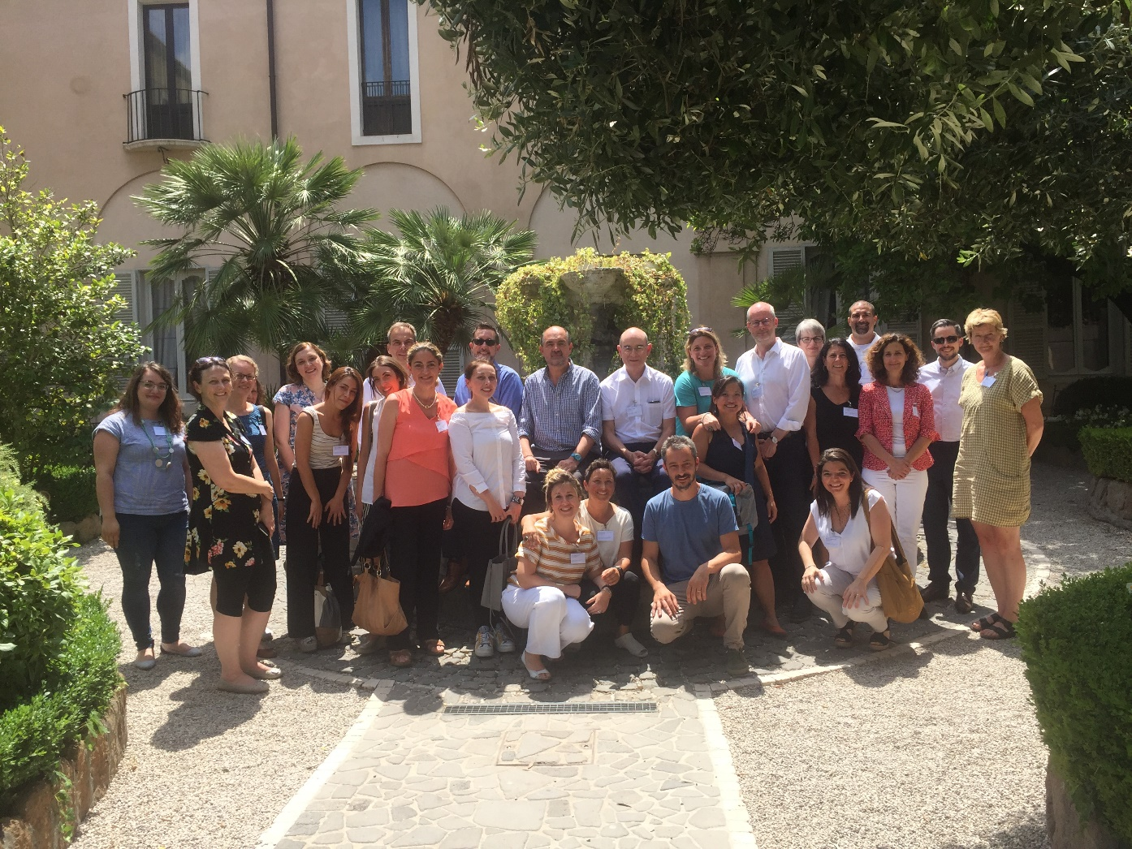
WORKSHOP
PATIENT AND PARENT ORIENTED TOOLS TO ASSESS HEALTH-RELATED QUALITY OF LIFE, ACTIVITY OF DAILY LIVING AND CAREGIVER BURDEN IN SMA.
Rome, July 13, 2019
25 participants from Italy, United States, United Kingdom, Germany, Spain and Switzerland met to discuss Patient Reported Outcome Measures (PROM) in Spinal Muscular atrophy (SMA). The group included physicians and physical therapists with a specific experience in developing or validating PROMS in neuromuscular disorders, advocacy groups and representatives from pharmaceutical companies.

Slide 21
AIMS
to explore the different PROMS currently or previously used in SMA,
to better define the domains explored by each of them, also in relation to age and SMA type,
to define a roadmap of possible tools to be used in different settings and
define areas where further research is needed.
During the workshop, all participants contributed to review the published evidence in each area and to report current practice amongst the group.

Slide 22
Eugenio Mercuri (Catholic University, Rome) introduced the workshop, highlighting the main aims.
REVISION OF THE EXISTING TOOLS
Sonia Messina (University of Messina, Messina) provided the results of a critical overview of the existing tools,
performed in collaboration with Laura Antonaci and Annalia Frongia, (Catholic University, Rome).
Dylan Trundell and Ksenija Gorni from Roche presented the SMA Independence Scale (SMAIS).
Valeria Sansone (Nemo Center, Milan) reported the development of SMA HI.
Amy Pasternack (Boston Children’s Hospital) reported the PNCR experience using the PEDI-CAT.
Jackie Montes (Columbia University, New York) provided a review of the tools used to assess fatigue differentiating tools assessing perceived fatigue (subjective) from the physiological fatigue.
Anna Lia Frongia (Catholic University, Rome) provided a review of other tools used in other neuromuscular disorders but not in SMA.
Erik Henrikson (UC Davis) reported the CNRG experience in the correlation between PROMS (PedsQL and PODCI) and functional measures in Duchenne muscular dystrophy (DMD).

Slide 23
PATIENTS/FAMILIES’ AND COMPANIES’ EXPECTATIONS
•What do we know about patients/families’ expectations or priorities?
Mencia de Lemus Belmonte, Nicole Gusset, Mary Schroth
(Review of recent surveys: SMA Europe/Cure SMA/italian/ others)
•What do we know about companies’ expectations or priorities?
Marcus Droege, Lydie Renault (Avexis)
Ivana Rubino,
Chiara Marchesi (Biogen)
Dylan Trundell, Ksenija Gorni (Roche)

Slide 24
PLENARY DISCUSSION
•Can we define priorities about expectations at different ages/type of SMA/ functional level etc.?
•Are these aspects captured by the existing tools?
•Can we define a roadmap of the tools capturing these aspects at different ages/type of SMA/ functional level etc
•Criteria for “qualification” as a disease specific outcome measure. Is this the gold standard? How should this be used as a basis for this effort?
Gaps and future
1. Where are the gaps?
2. Pilot/validate existing scales
3. Do we need new measures?– what can be borrowed from other scales and what new needs to be developed?
4. Workshop report
A detailed workshop report will be published soon.

Slide 25
MAIN CONCLUSIONS
A significant effort is needed to define priorities about expectations at different ages/type of SMA/ functional level etc.
Several working groups have been identified to validate some of the existing tools (e.g. SMAIS and SMA HI) in larger cohorts and different SMA type and functional levels.
We do not need new measures, but a proper validation of selected tools and possibly add-on modules to increase sensitivity to changes in different SMA types.
The biggest gap is related to tools available for infants with SMA type I.
Tools to assess specific functions (e.g. swallowing) have to be better defined as possible target of new therapies effectiveness especially in SMA type I.
A detailed workshop report will be published soon.

Slide 26


Acknowledgments

